Slide 1
Information Retrieval
Topic- XML Retrieval
(Vector space model for XML IR)
Lecture-33
Prepared By
Dr. Rasmita Rautray & Dr. Rasmita Dash
Associate Professor
Dept. of CSE

Slide 2
XML Retrieval

Slide 3
Content
XML Retrieval
XML Retrieval : Vector space model
XML Retrieval : Assessment

Slide 4
IR and relational databases
IR systems are often contrasted with relational databases (RDB).
Traditionally, IR systems retrieve information from unstructured text (“raw” text without markup).
RDB systems are used for querying relational data: sets of records that have values for predefined attributes such as employee number, title and salary.
RDB search unstructured IR
objects records unstructured docs
main data structure table inverted index model relational model vector space & others
queries SQL free text queries
Some structured data sources containing text are best modeled as structured documents rather than relational data ( Structured retrieval).

Slide 5
Structured retrieval
Basic setting: queries are structured or unstructured; documents are structured.
Applications of structured retrieval
Digital libraries, patent databases, blogs, tagged text with entities like persons and locations (named entity tagging).

Slide 6
Why RDB is not suitable in this case
Three main problems :
An unranked system (DB) would return a potentially large number of articles that mention the Vatican, the Coliseum and sightseeing tours without ranking them by relevance to the query.
Difficult for users to precisely state structural constraints -
may not know which structured elements are supported by the system.
tours AND(COUNTRY : Vatican OR
LANDMARK : Coliseum) ?
tours AND (STATE :Vatican OR BUILDING : Coliseum) ?
Users may be completely unfamiliar with structured search and advanced search interfaces or unwilling to use them.
Solution: adapt ranked retrieval to structured documents to address these problems.

Slide 7
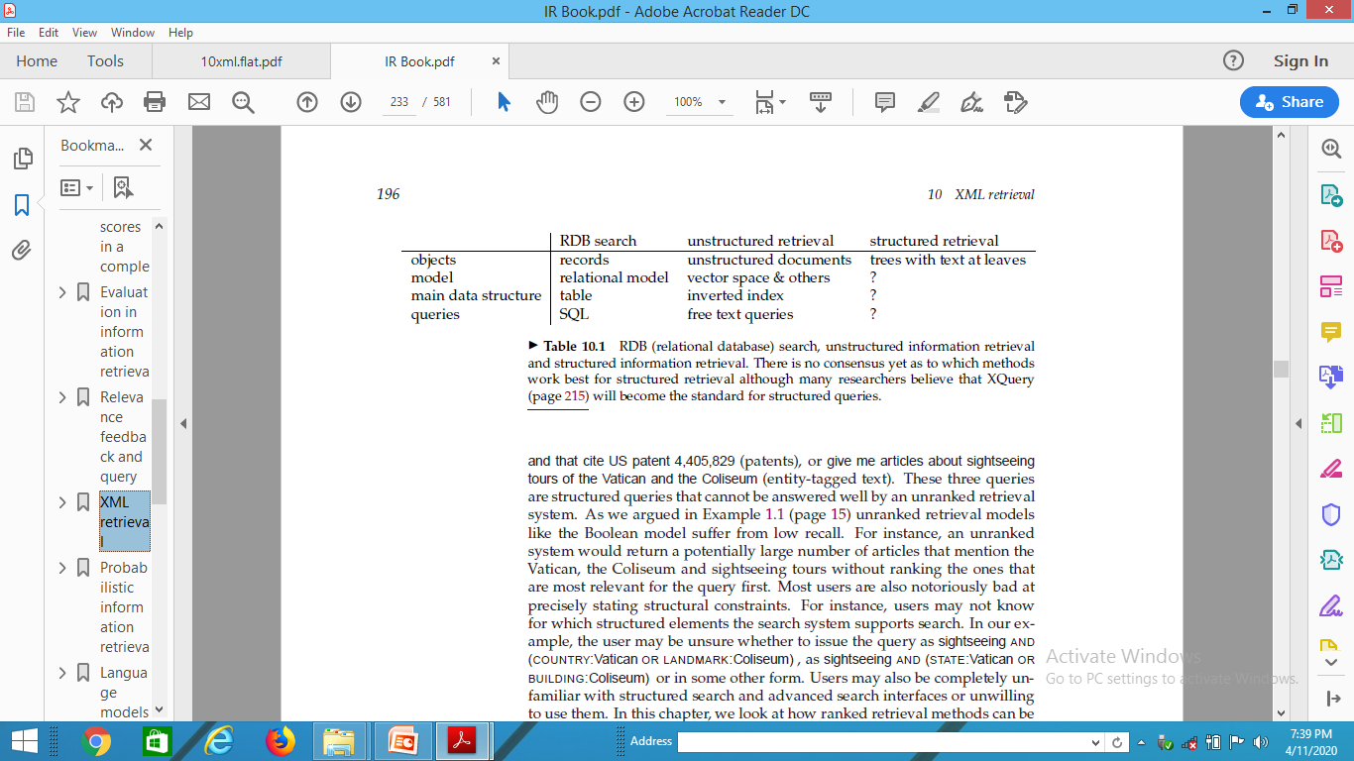
Structured Retrieval
Standard for encoding structured documents: Extensible Markup Language ( XML)
structured IR → XML IR
also applicable to other types of markup (HTML, SGML, ...)

Slide 8
First challenge: document parts to retrieve
Structured or XML retrieval: users want us to return parts of documents (i.e., XML elements), not entire documents as IR systems usually do in unstructured retrieval.
Example
If we query Shakespeare’s plays for Macbeth’s castle, should we return the scene, the act or the entire play?
In this case, the user is probably looking for the scene.
However, an otherwise unspecified search for Macbeth should return the play of this name, not a subunit.
Solution: structured document retrieval principle

Slide 9
Second challenge: document parts to index
Central notion for indexing and ranking in IR: document unit or indexing unit.
In unstructured retrieval, usually straightforward: files on your desktop, email messages, web pages on the web etc.
In structured retrieval, there are four main different approaches to defining the indexing unit.
non-overlapping pseudodocuments
top down
bottom up
all

Slide 10
Third challenge: nested elements
Because of the redundancy caused by nested elements it is common to restrict the set of elements eligible for retrieval. Restriction strategies include:
discard all small elements
discard all element types that users do not look at (working XML retrieval system logs)
discard all element types that assessors generally do not judge to be relevant (if relevance assessments are available)
only keep element types that a system designer or librarian has deemed to be useful search results
In most of these approaches, result sets will still contain nested elements.

Slide 11
Third challenge: nested elements
Further techniques:
remove nested elements in a post processing step to reduce redundancy.
collapse several nested elements in the results list and use highlighting of query terms to draw the user’s attention to the relevant passages.

Slide 12
Nested elements and term statistics
Further challenge related to nesting: we may need to distinguish different contexts of a term when we compute term statistics for ranking, in particular inverse document frequency (idf).
Example
The term Gates under the node author is unrelated to an occurrence under a content node like section if used to refer to the plural of gate. It makes little sense to compute a single document frequency for Gates in this example.
Solution: compute idf for XML-context term pairs.
sparse data problems (many XML-context pairs occur too rarely to reliably estimate df)
compromise: consider the parent node x of the term and not the rest of the path from the root to x to distinguish contexts.

Slide 13
Vector space model for XML IR

Slide 14
Main idea: lexicalised subtrees
Aim: to have each dimension of the vector space encode a word together with its position within the XML tree.
How: Map XML documents to lexicalised subtrees.

Slide 15
Main idea: lexicalised subtrees
Take each text node (leaf) and break it into multiple nodes, one for each word. E.g. split Bill Gates into Bill and Gates.
Define the dimensions of the vector space to be lexicalized subtrees of documents – subtrees that contain at least one vocabulary term.

Slide 16
Lexicalised subtrees
We can now represent queries and documents as vectors in this space of lexicalized subtrees and compute matches between them,
e.g. using the vector space formalism.
Vector space formalism in unstructured VS. structured IR
The main difference is that the dimensions of vector space in unstructured retrieval are vocabulary terms whereas they are lexicalized subtrees in XML retrieval.

Slide 17
Structural term
There is a tradeoff between the dimensionality of the space and accuracy of query results.
If we restrict dimensions to vocabulary terms, then we have a standard vector space retrieval system that will retrieve many documents that do not match the structure of the query (e.g., Gates in the title as opposed to the author element).
If we create a separate dimension for each lexicalized subtree occurring in the collection, the dimensionality of the space becomes too large.
Compromise: index all paths that end in a single vocabulary term, in other words, all XML-context term pairs. We call such an XML-context term pair a structural term and denote it by <c, t>: a pair of XML-context c and vocabulary term t.

Slide 18
Context resemblance
A simple measure of the similarity of a path c_{q} in a query and a path c_{d} in a document is the following context resemblance function C_{R}:
if c_{q} matches c_{d}
if c_{q} does not match c_{d}
|c_{q}| and |c_{d} are the number of nodes in the query path and document path, resp.
c_{q} matches c_{d} iff we can transform c_{q} into c_{d} by inserting additional nodes.
(1)

Slide 19
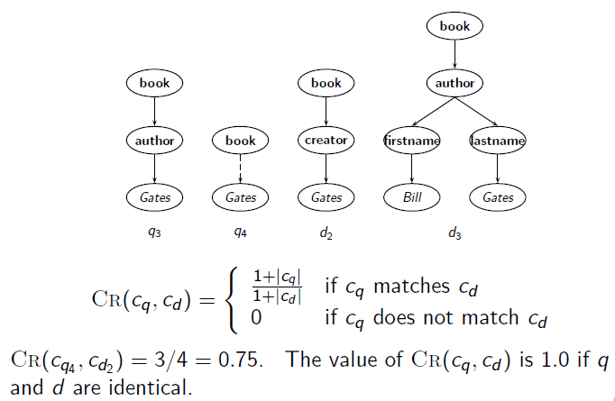
Context resemblance example

Slide 20
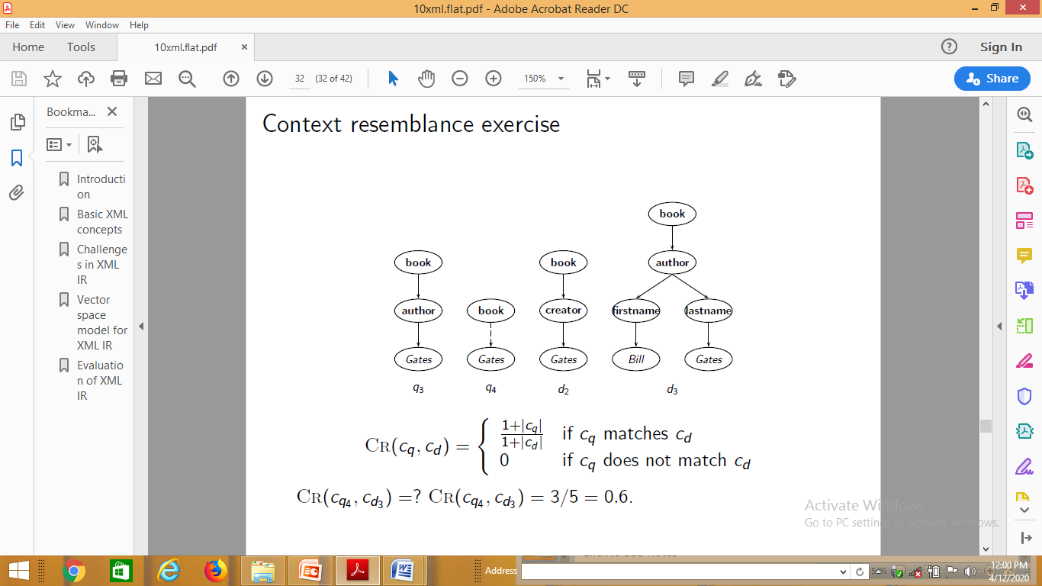
Context resemblance exercise

Slide 21
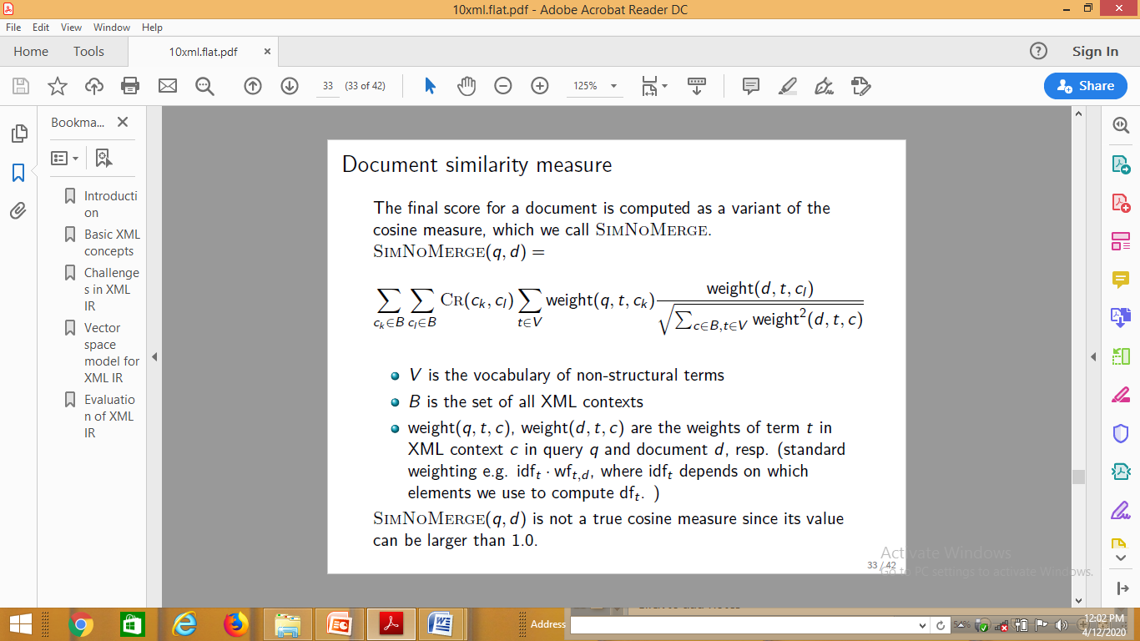
Document similarity measure

Slide 22
Evaluation of XML Retrieval

Slide 23
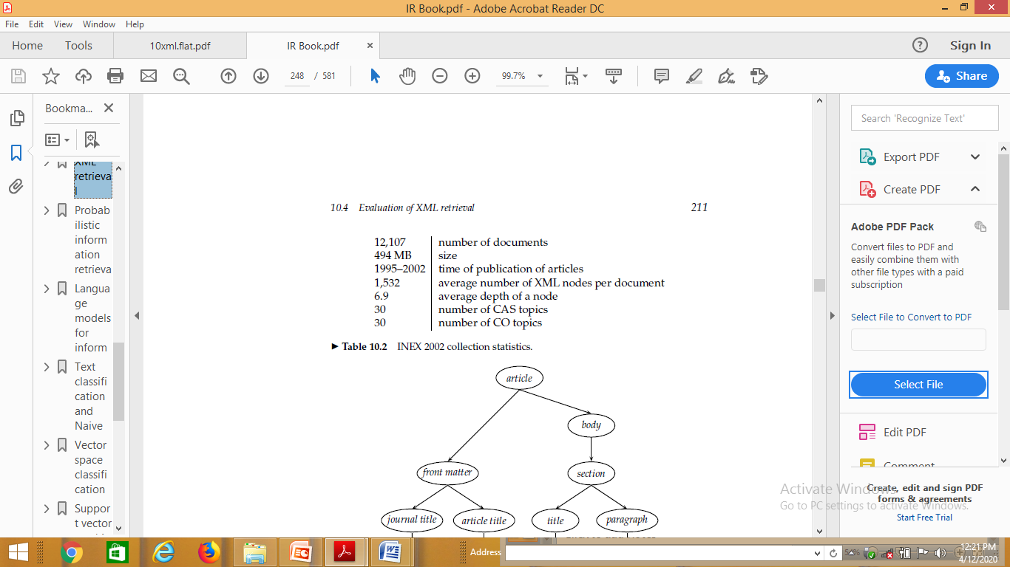
Initiative for the Evaluation of XML Retrieval (INEX)
INEX: standard benchmark evaluation (yearly) that has produced test collections (documents, sets of queries, and relevance judgments).
Based on IEEE journal collection (since 2006 INEX uses the much larger English Wikipedia as a test collection).
The relevance of documents is judged by human assessors.
INEX 2002 collection statistics

Slide 24
INEX topics
Two types:
content-only or CO topics: regular keyword queries as in unstructured information retrieval
content-and-structure or CAS topics: have structural constraints in addition to keywords
Since CAS queries have both structural and content criteria, relevance assessments are more complicated than in unstructured retrieval.

Slide 25
INEX relevance assessments
INEX 2002 defined component coverage and topical relevance as orthogonal dimensions of relevance.
Component coverage
Evaluates whether the element retrieved is “structurally” correct, i.e., neither too low nor too high in the tree.
We distinguish four cases:
Exact coverage (E): The information sought is the main topic of the component and the component is a meaningful unit of information.
Too small (S): The information sought is the main topic of the component, but the component is not a meaningful (self-contained) unit of information.
Too large (L): The information sought is present in the component, but is not the main topic.
No coverage (N): The information sought is not a topic of the Component.

Slide 26
INEX relevance assessments
The topical relevance dimension also has four levels: highly relevant (3), fairly relevant (2), marginally relevant (1) and nonrelevant (0).
Combining the relevance dimensions
Components are judged on both dimensions and the judgments are then combined into a digit-letter code, e.g. 2S is a fairly relevant component that is too small. In theory, there are 16 combinations of coverage and relevance, but many cannot occur. For example, a nonrelevant component cannot have exact coverage, so the combination 3N is not possible.

Slide 27
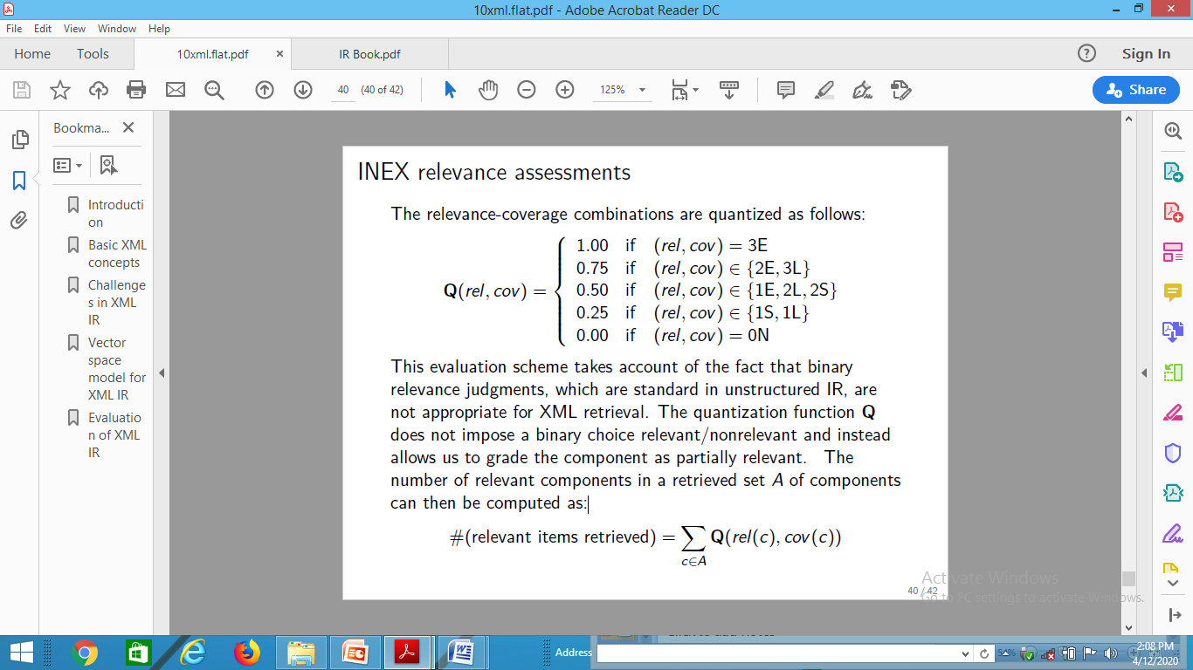

INEX relevance assessments
The relevance-coverage combinations are quantized as follows:
This evaluation scheme takes account of the fact that binary relevance judgments, which are standard in unstructured IR, are not appropriate for XML retrieval. The quantization function Q does not impose a binary choice relevant / non-relevant and instead allows us to grade the component as partially relevant. The number of relevant components in a retrieved set A of components can then be computed as:

Slide 28
INEX evaluation measures
Recent INEX focus: develop algorithms and evaluation measures that return non-redundant results lists and evaluate them properly.

Slide 29
Thank You

